Slide 1

Configuration Management in DevOps
DevOps and Configuration Management work hand in hand to provide effective software development and deployment. This presentation will explore how Configuration Management is an essential ingredient in the DevOps process.
CS
by Charanjit Singh

Slide 2

What is Configuration Management?
1
Definition 🔍
2
Benefits ✅
3
Goals 🎯
Configuration Management is the practice of tracking and managing changes to software code, associated documentation, and test artifacts.
By utilizing Configuration Management practices, teams can better manage the development process, improve the quality of the final codebase, and reduce the risk of downtime or outages.
Configuration Management ensures that all changes to code and any associated documents are tracked, resulting in a reliable and traceable source of truth for a given project.

Slide 3



Importance of Configuration Management in DevOps
Accelerated Release Cycles 🚀
Collaboration & Communication 💬
Consistency & Accuracy ⚖️
Configuration Management streamlines code delivery, reducing cycle times and allowing faster iterations and more frequent releases.
Configuration Management ensures team members can easily share code, collaborate on projects, and communicate effectively across different platforms or locations.
Configuration Management guarantees that all code changes are documented, tested, and standardized, ensuring consistency and accuracy across the project.

Slide 4
Configuration Management Tools
Git 🌳
Chef 🍴
Puppet 🤡
The most widely used distributed version control system. It provides a platform for storing and managing code changes, allowing for easy collaboration and sharing.
A configuration management tool that automates the provisioning, configuration, and management of servers and applications. It can be used for both small and large deployments.
A configuration management tool that is known for its ability to manage the infrastructure of large-scale and highly complex deployments. It is used by many well-known companies around the world.
Jenkins 🚦
A continuous integration and delivery tool that allows developers to test and build code automatically. Jenkins integrates with many Configuration Management tools and is highly customizable.

Slide 5
Common Challenges in Configuration Management
1
Team Integration 🤝
Teams may have difficulties integrating Configuration Management tools, resulting in poor communication, ineffective collaboration, and delays in the development process.
2
Tools Compatibility 🛠️
Choosing the right Configuration Management tool requires careful consideration of variables such as budget, infrastructure requirements, and specific features needed by the team.
3
Change Control 🔧
With Configuration Management, changes are constantly being made to software and associated documentation, which can make it difficult to track and manage these changes effectively.

Slide 6



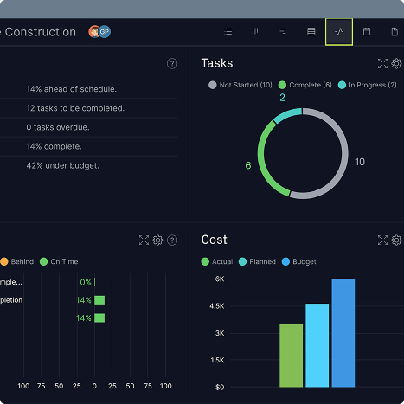
Best Practices for Configuration Management in DevOps
Standardization 📐
Effective Collaboration 💬
Knowledge Management 🤓
Continuous Improvement 🔨
Teams must establish consistent processes and procedures for Configuration Management and ensure that every team member follows these procedures.
Collaboration is key to successful Configuration Management. Teams must work together to define clear objectives, identify pain points, and implement effective solutions.
Teams must maintain up-to-date documentation, guidelines, and procedures, and make sure that this information is easily accessible by anyone who needs it.
Teams must regularly review and evaluate Configuration Management processes and tools and use metrics to identify areas of potential improvement.

Slide 7

Conclusion and Key Takeaways
1
Importance 🌟
2
Challenges 🤔
3
Best practices 👍
Effective Configuration Management is essential to successful DevOps processes and helps to ensure the delivery of high-quality, reliable code.
Teams must be aware of and address common challenges associated with Configuration Management, such as team integration, tools compatibility, and change control.
Following best practices including standardization, effective collaboration, knowledge management, and continuous improvement can help teams to overcome these challenges and leverage Configuration Management for better development and deployment outcomes.

